Slide 1
Linear Classification

Slide 2
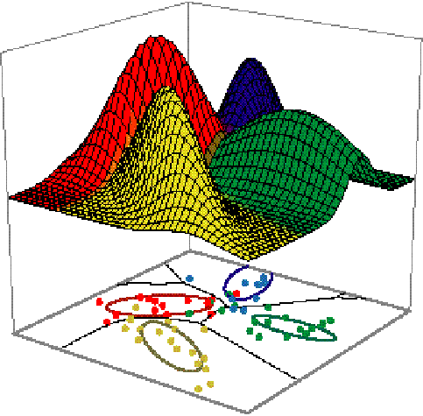
Idea

Slide 3
Linear discriminant function
Definition
  It is a function that is a linear combination of the components of x
  g(x) = w^{t}x + w₀ (1)
  where w is the weight vector and w₀ the bias
A two-category classifier with a discriminant function of the form (1) uses the following rule:
Decide ω₁ if g(x) > 0 and ω₂ if g(x) < 0
⇔ Decide ω₁ if w^{t}x > -w₀ and ω₂ otherwise
If g(x) = 0 ⇒ x is assigned to either class

Slide 4
Decisions surface
  The equation g(x) = 0 defines the decision surface that separates points assigned to the category ω₁ from points assigned to the category ω_{2.}
  When g(x) is linear, the decision surface is a hyperplane.
  Algebraic measure of the distance from x to the hyperplane (interesting result!)

Slide 5
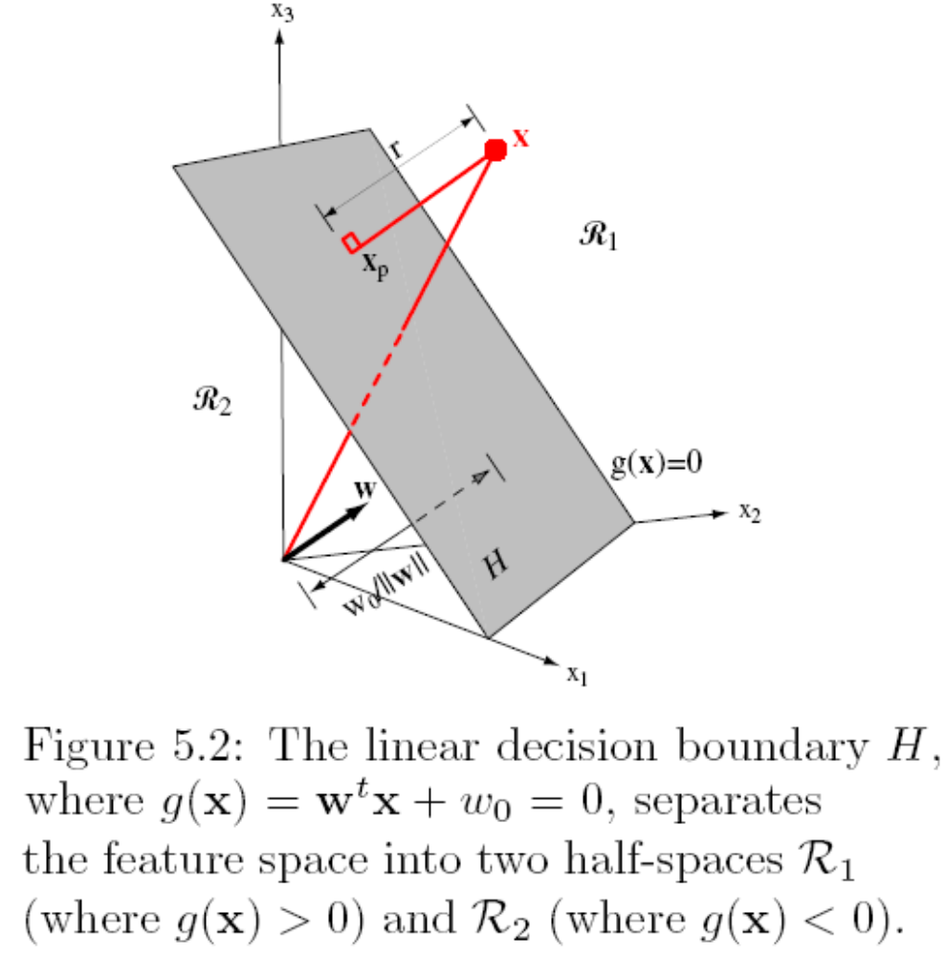


Slide 6
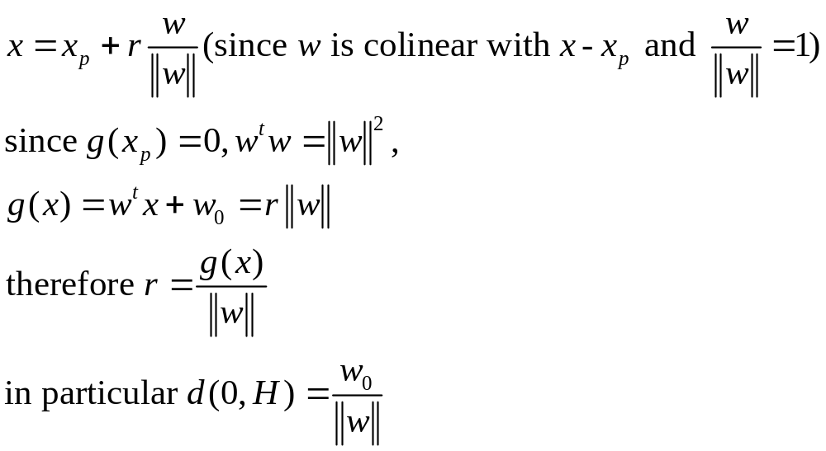
Geometric analysis
The orientation of the surface is determined by the normal vector w and the location of the surface is determined by the bias.

Slide 7
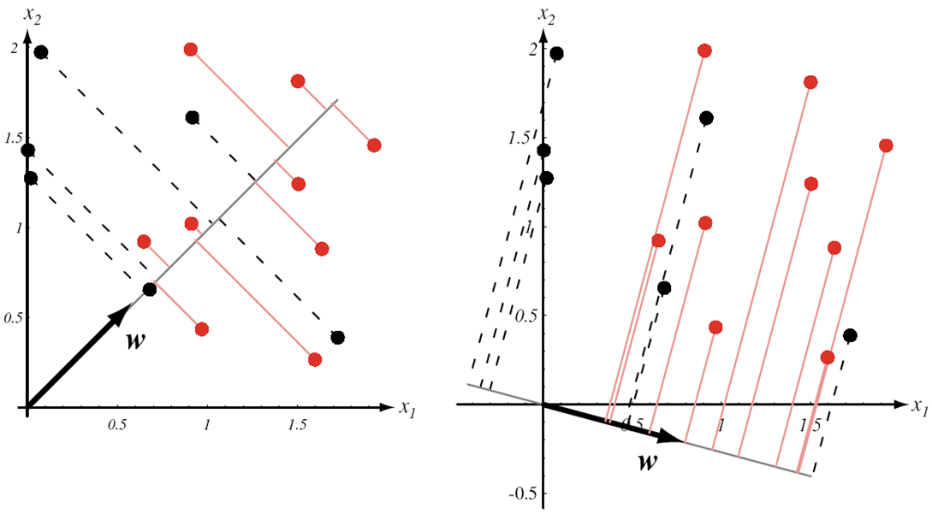
Fisher Linear Discriminant Analysis (FLDA)

Slide 8
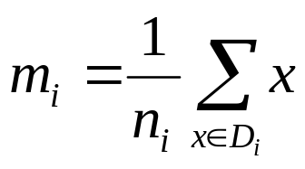
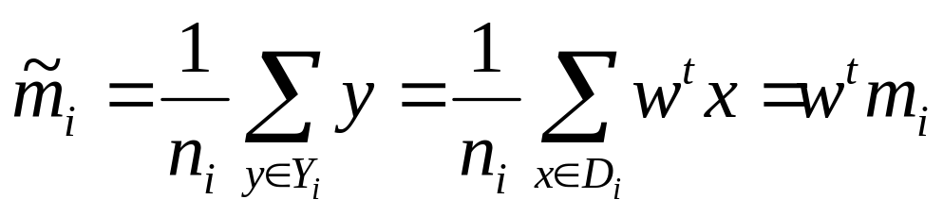
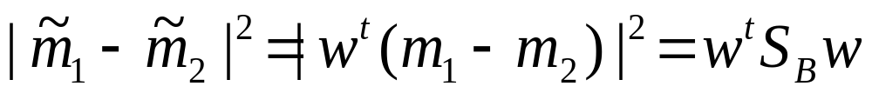
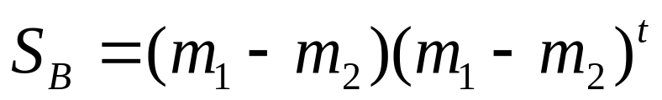
X={x₁, x₂,…, x_{n}}=D₁UD₂
y=w^{t}x : X Y={y₁, y₂,…,y_{n}}=Y₁UY₂
Sample mean
after projection
where is between-class scatter matrix.
rank(S_{B})≤1

Slide 9
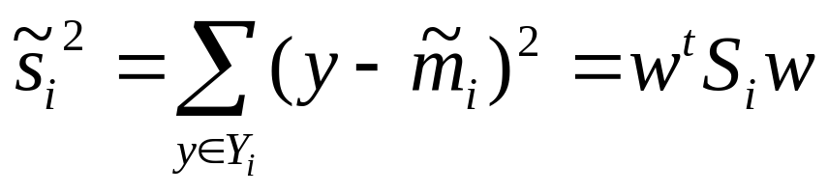
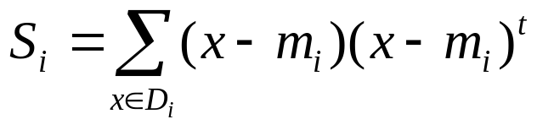
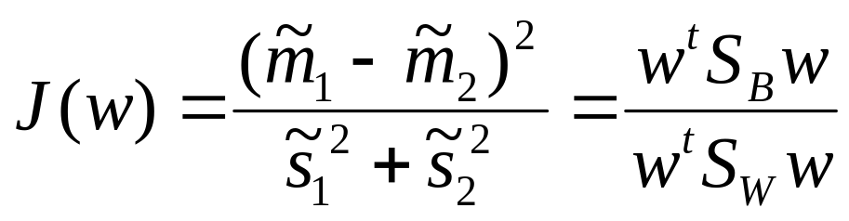
where is within-class scatter matrix of class ω_{i}
The sum of these scatters can be written S_{W}=S₁+S₂
Fisher criterion function：

Slide 10
A vector w that maximizes J(w) must satisfy S_{B}w=λS_{W}w, which is a generalized eigenvalue problem
If S_{W} is nonsingular, S_{W}⁻¹S_{B}w=λw
In our particular case, it is unnecessary to solve for the eigenvalues and eigenvectors of S_{W}⁻¹S_{B}，due to the fact that S_{B}w is always in the direction of m₁-m₂.
Since the scale factor for w is immaterial, the solution for the w that optimizes J(w)：w=S_{W}⁻¹(m₁-m₂)

Slide 11
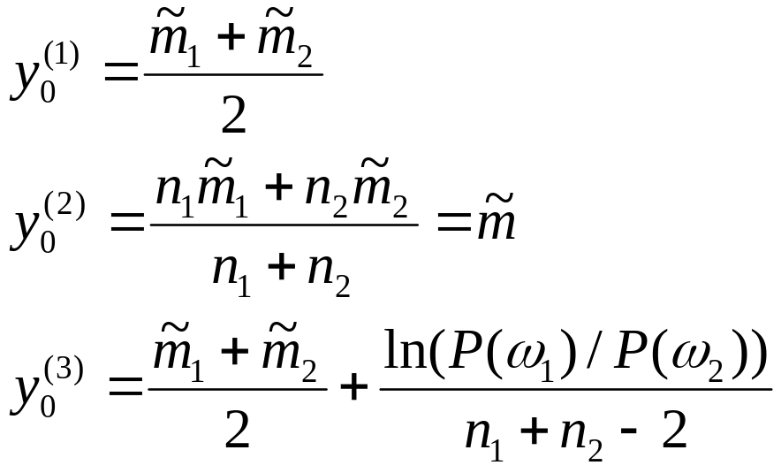
How to find y₀ ?
Bayesian optimal rule
Experience
If y>y₀ ω = ω₁ ;otherwise ω = ω₂

Slide 12
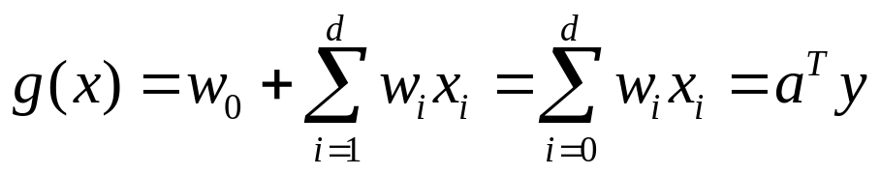
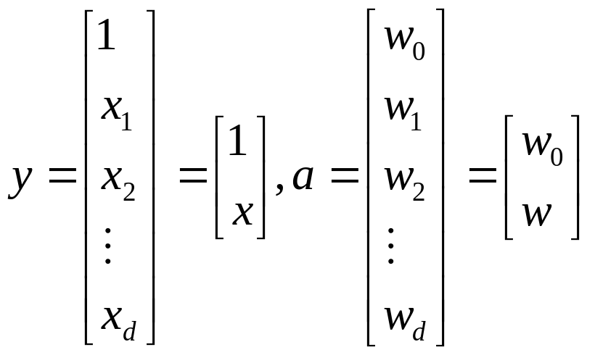
Augmented feature vector y and augmented weight vector a
where

Slide 13
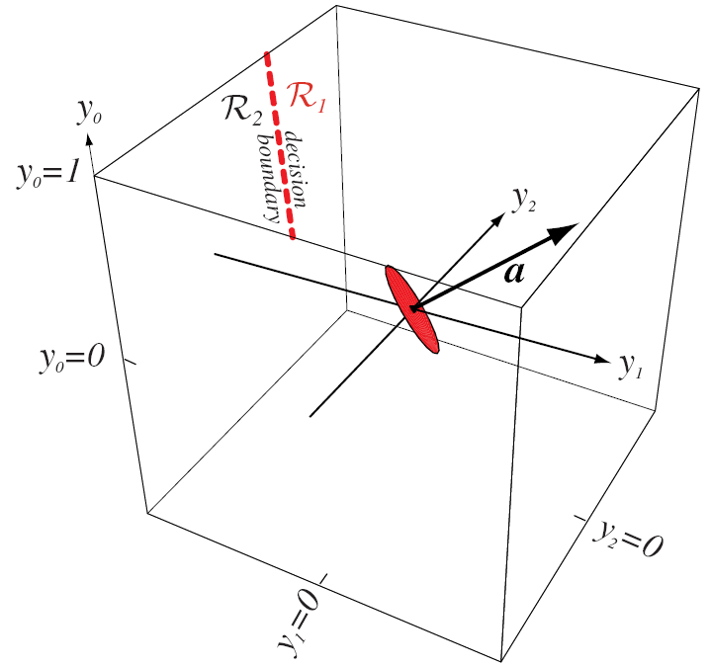

Slide 14
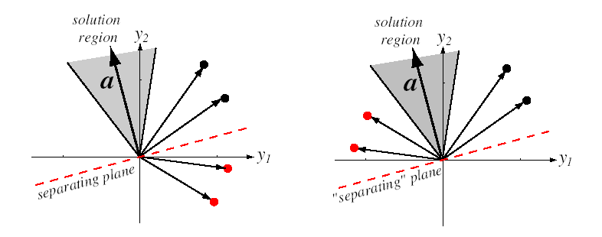
Linearly separable and normalization
unnormalized normalized

Slide 15
Solution vector
If solution vector exists, it is not unique.
Additional limiting condition
  seek a unit-length solution vector that maximizes the minimum distance from the samples to the separating plane.
  seek the minimum-length weight vector satisfying a^{t}y_{i}>b for all i, where b is a positive constant called the margin.
Define a criterion function J(a) that is minimized if is a solution vector.

Slide 16
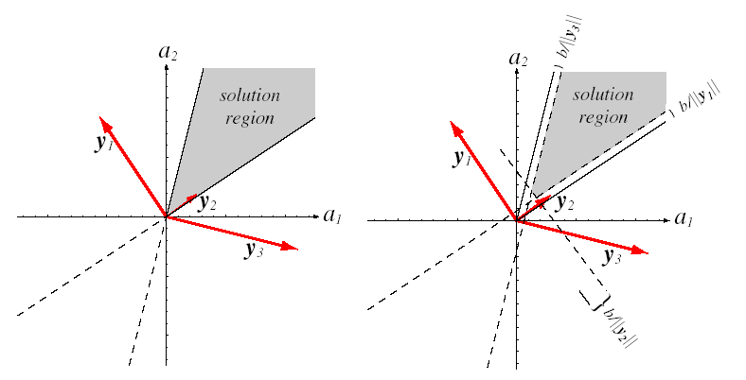
Margin
without margin with margin

Slide 17
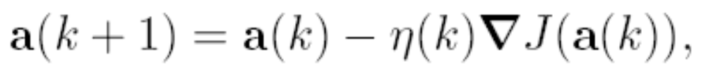
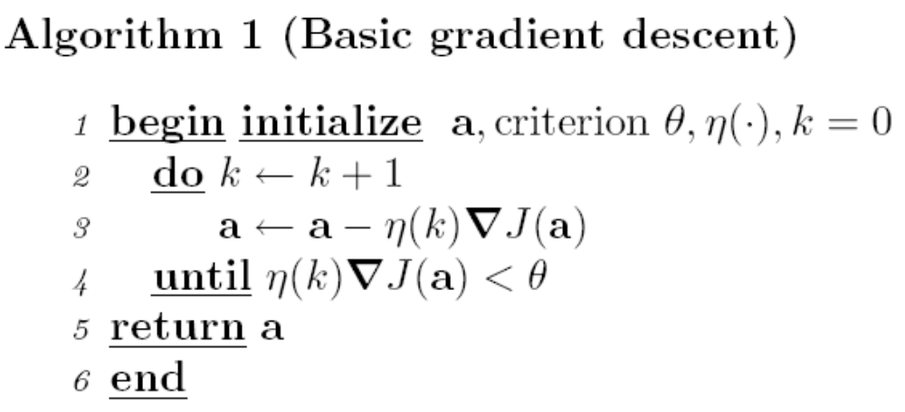
Gradient descent procedures
η(k) is learning rate that sets the step size

Slide 18
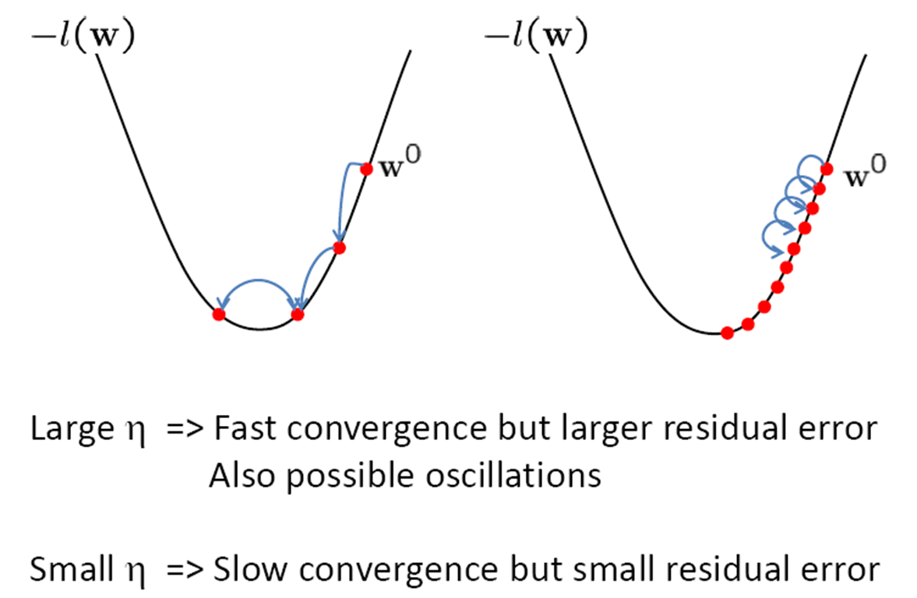
Effect of step-size η

Slide 19
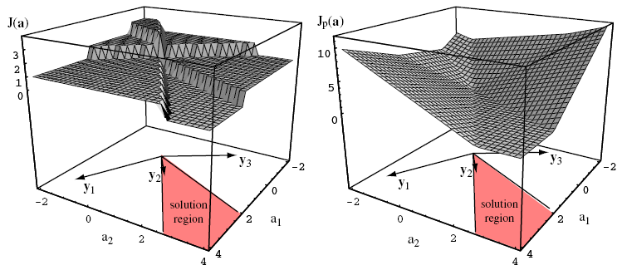
Perceptron
The number of perceptron criterion
misclassified samples

Slide 20
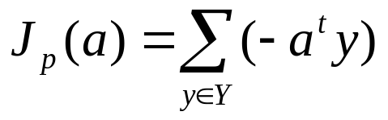
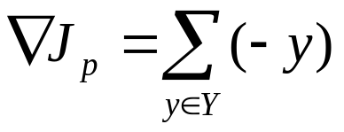
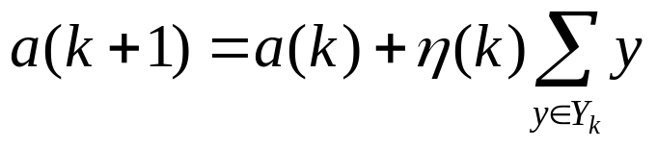
Criterion function
Y is the set of samples misclassified by a. (If no samples are misclassified, Y is empty and we define J_{p}(a) to be 0.)

Slide 21
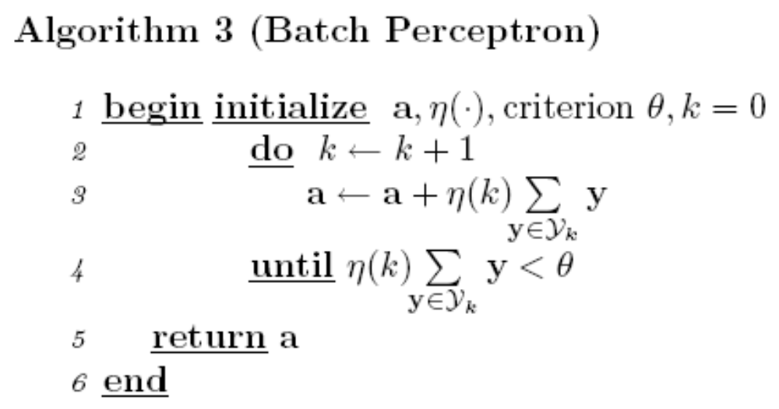
Batch perceptron algorithm

Slide 22
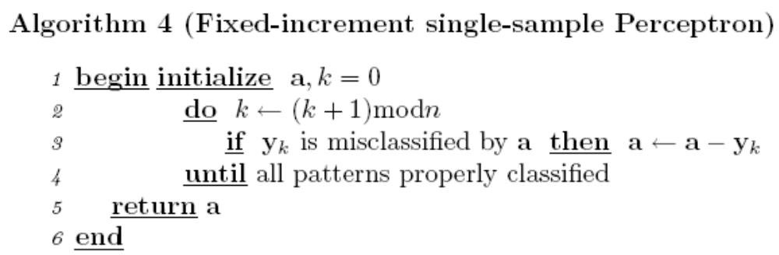
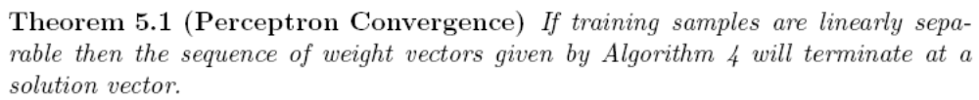
Fixed-increment single-sample perceptron

Slide 23
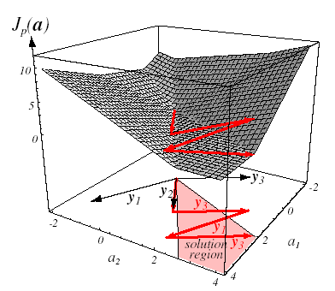
Example

Slide 24
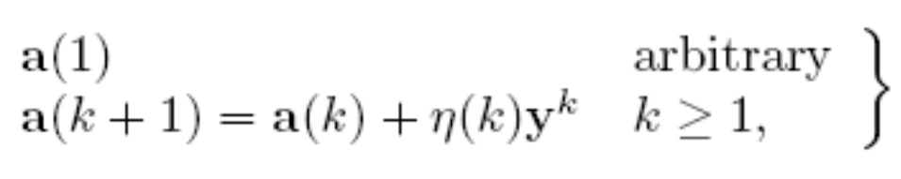
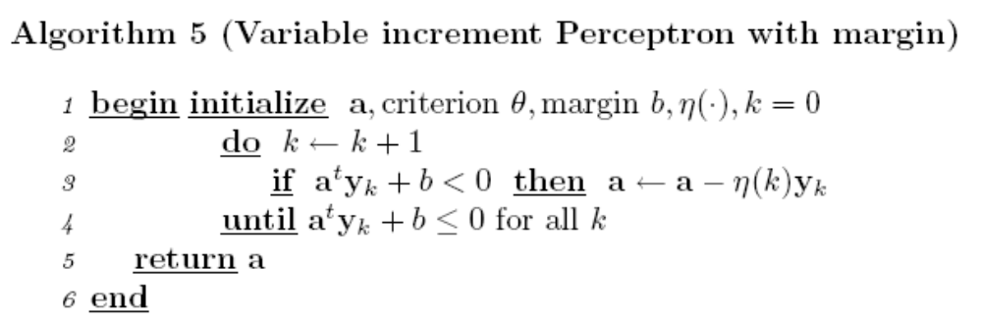
Variable increment perceptron with margin

Slide 25
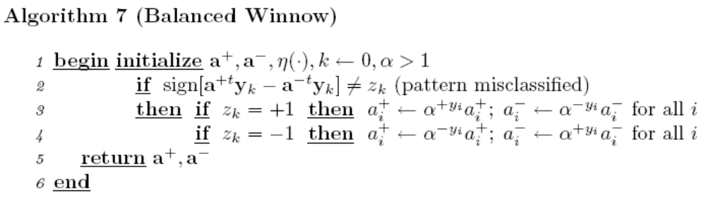
Balanced Winnow

Slide 26
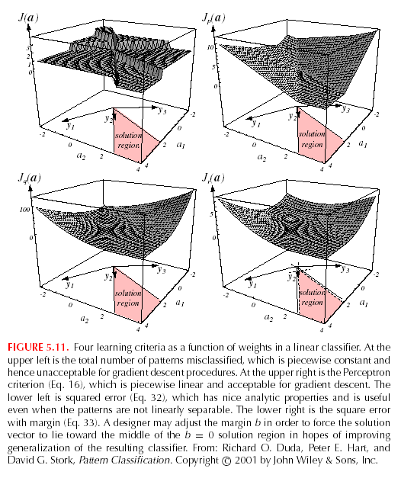
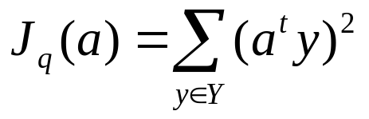
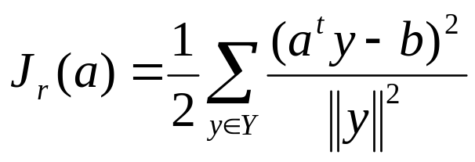
Relaxation procedures

Slide 27
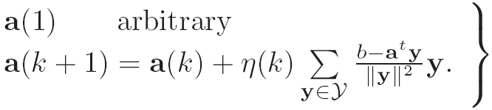
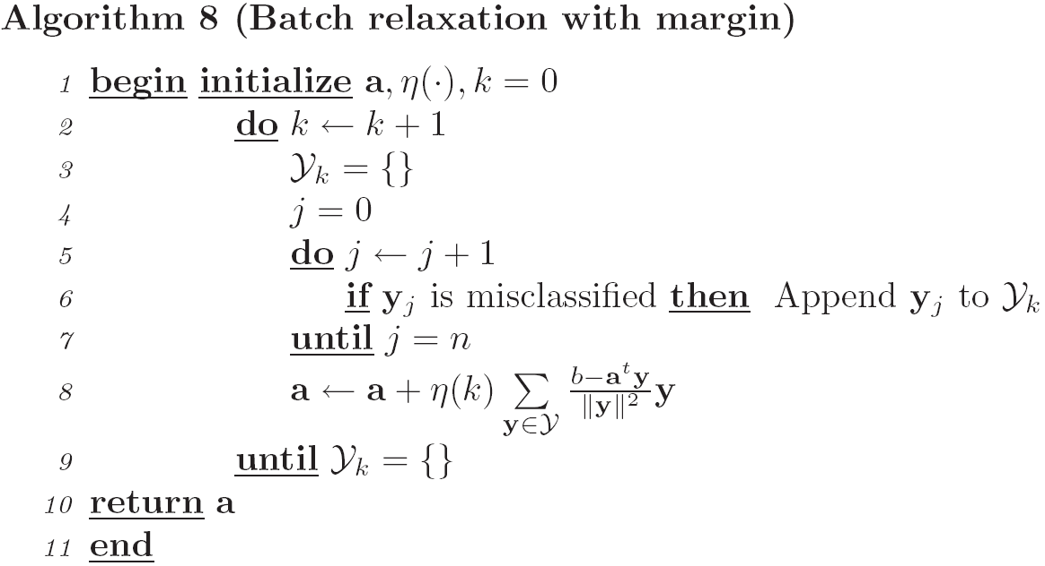
Batch relaxation with margin

Slide 28
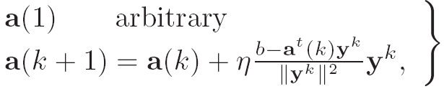
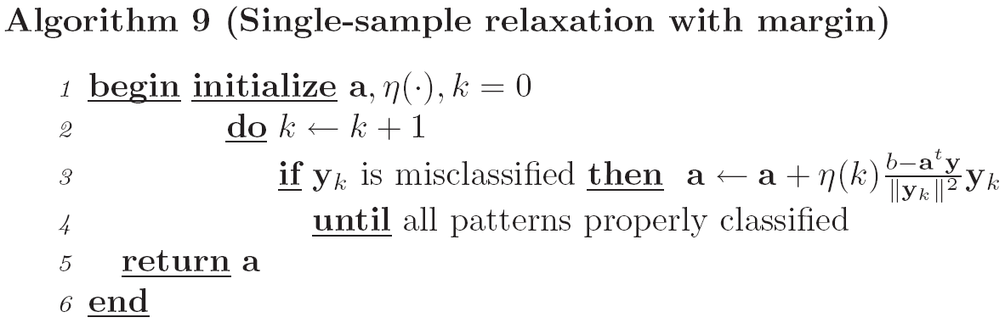
Single-sample relaxation with margin

Slide 29
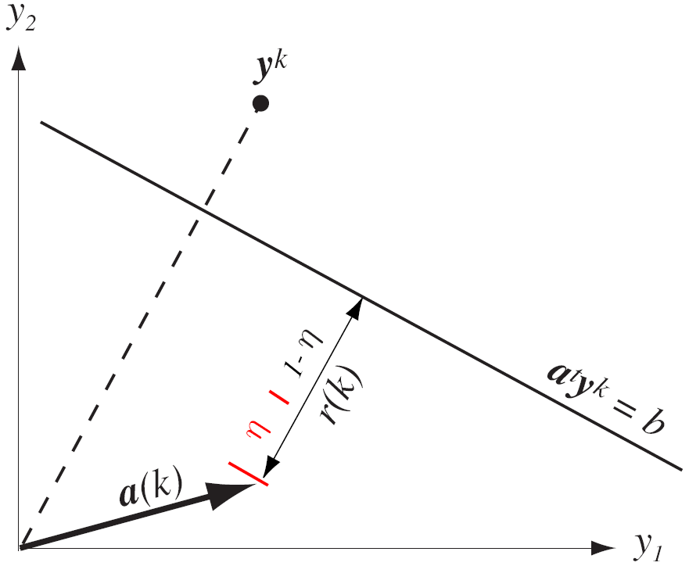
Geometric explanation

Slide 30
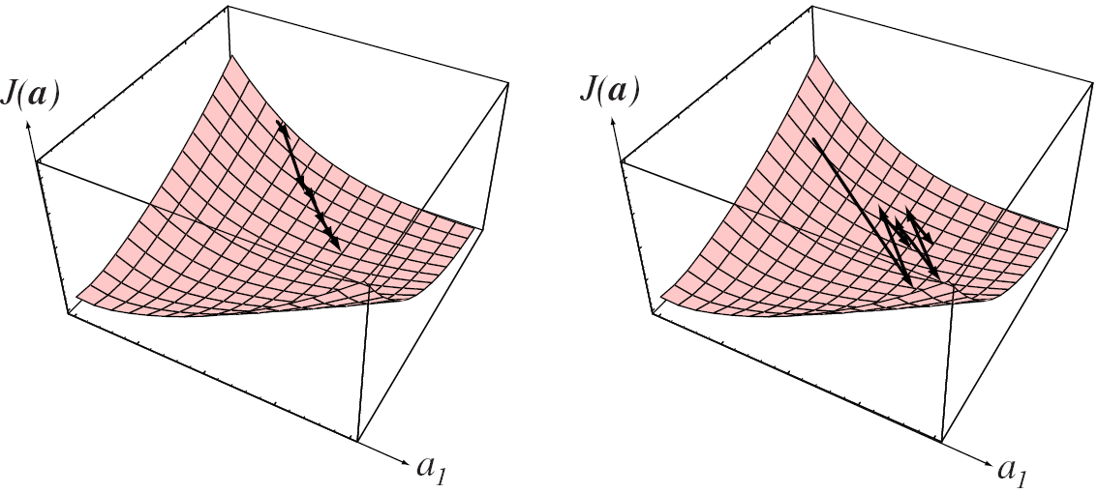
a^{t} (k+1) y^{k}-b=(1-η) (a^{t} (k) y^{k}-b) (0<η<2)
If η<1，then a^{t} (k+1) y^{k} is still less than b “underrelaxation”
If η>1，then a^{t} (k+1) y^{k} greater than b “overrelaxation”

Slide 31
Nonseparable behavior
Error-correcting procedures
Since no weight vector can correctly classify every sample in a nonseparable set (by definition), it is clear that the corrections in an error-correction procedure can never cease.

Slide 32
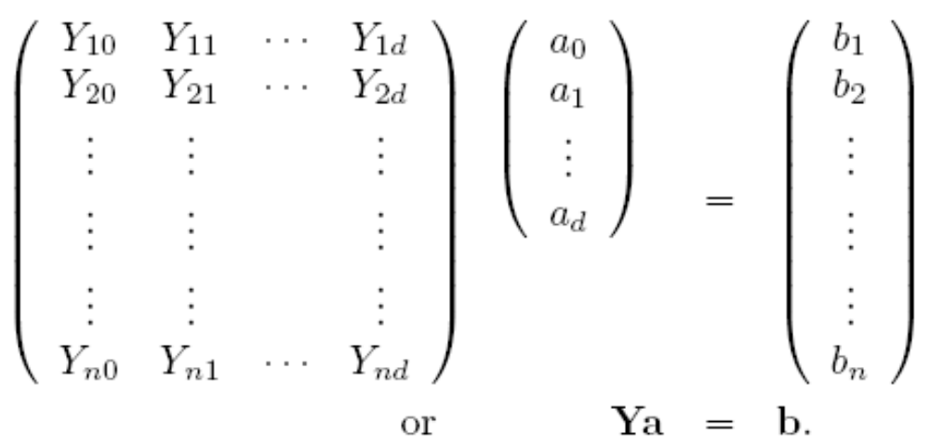
Minimum Squared Error Procedures
try to make a^{t}y_{i}=b_{i}，where b_{i} are some arbitrarily specified positive constants.

Slide 33
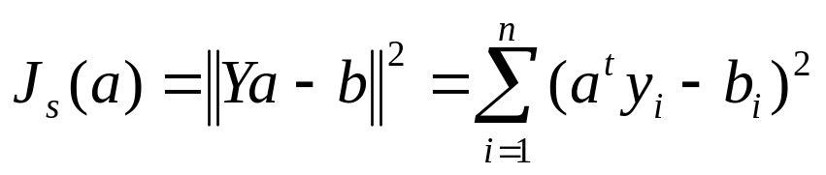
Minimum squared error criterion
IfY is nonsingular，a=Y⁻¹b.
IfY is rectangular (usually more equations than unknowns), a is overdetermined, and ordinarily no exact solution exists
Two ways to minimize J_{s}(a)
  Pseudoinverse
  Widrow-Hoff procedure

Slide 34
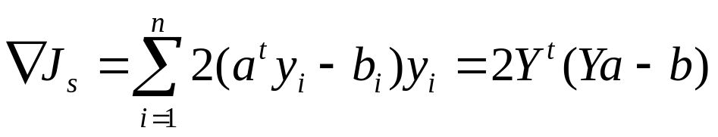



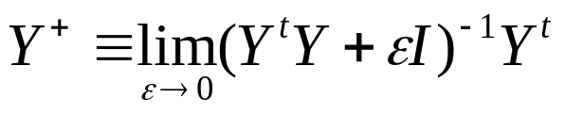
Pseudoinverse

Slide 35
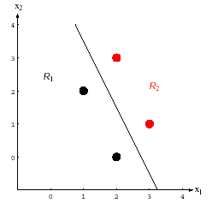
Example

Slide 36
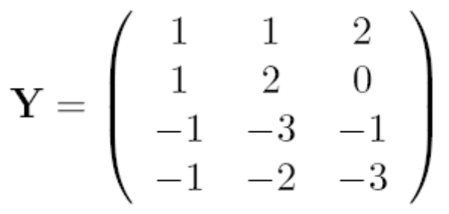
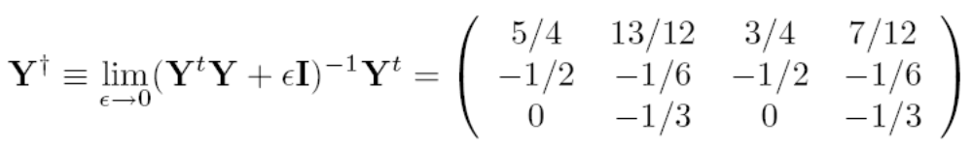
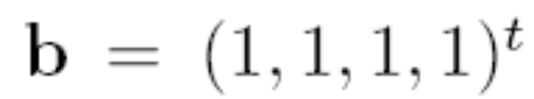
Hyperplane: 4x₁+2x₂-11=0

Slide 37
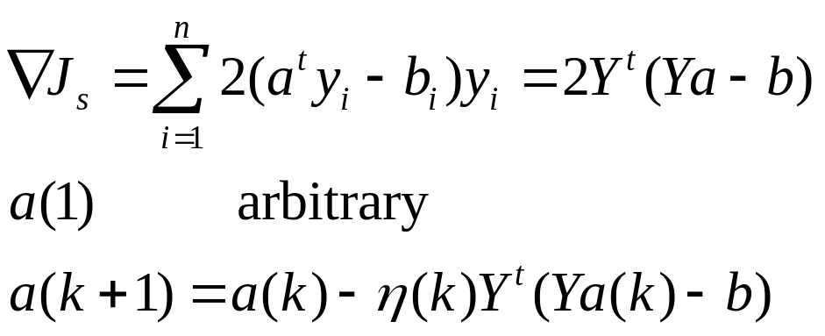
Widrow-Hoff procedure
If η(k) = η(1)/k, where η(1) is any positive constant, then this rule generates a sequence of weight vectors that converges to a limiting vector a satisfying

Slide 38
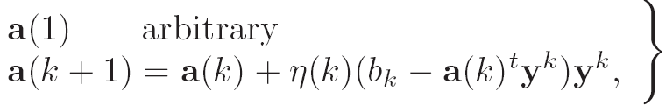

Least Mean Squared (LMS)

Slide 39


Slide 40



Ho-Kashyap Procedures
MSE criterion
If linearly separable, then
But we usually do not know beforehand.
If the samples are separable, and if both a and b in J_{s}(a) are allowed to vary (b>0), then the minimum value of J_{s} is zero, and a that achieves that minimum is a separating vector.

Slide 41




We are not so free to modify b, since b>0, and we must avoid converging to b=0. One way is to start with b>0 and to refuse to reduce any of its components.
set 0

Slide 42



where

Slide 43

e(k)=0 and we have a solution
e(k)≤0 and we have proof that the samples are not linearly separable.

Slide 44

Modification (I)
Y^{t}e(k)=0
It varies both the weight vector a and the margin vector b
It provides evidence of nonseparability
But it requires the computation of Y⁺.

Slide 45


Modification (II)
Avoid the need for computing Y⁺
where R is an arbitrary, constant, positive-definite matrix.
Assuring convergence if 0< η < 2/λ_{max}，λ_{max} is the largest eigenvalue of Y^{t}Y.

Slide 46


The multi-category case

Slide 47

We define c linear discriminant functions
and assign x to ω_{i} if g_{i}(x) > g_{j}(x) ∀ j ≠ i ; in case of ties, the classification is undefined.
    In this case, the classifier is a “linear machine”.

Slide 48

    A linear machine divides the feature space into c decision regions, with g_{i}(x) being the largest discriminant if x is in the region R_{i}
    For a two contiguous regions R_{i} and R_{j}; the boundary that separates them is a portion of hyperplane H_{ij} defined by:
      g_{i}(x) = g_{j}(x)
    (w_{i} – w_{j})^{t}x + (w_{i0} – w_{j0}) = 0
    w_{i} – w_{j} is normal to H_{ij} and

Slide 49

is a Linear Classifier!
  It is easy to show that the decision regions for a linear machine are convex, this restriction limits the flexibility and accuracy of the classifier.

Slide 50

Generalized Linear Discriminant Functions

Slide 51
Decision boundaries which separate between classes may not always be linear.
The complexity of the boundaries may sometimes request the use of highly nonlinear surfaces.
A popular approach to generalize the concept of linear decision functions is to consider a generalized decision function as:
    g(x) = w₁f₁(x) + w₂f₂(x) + … + w_{N}f_{N}(x) + w_{N+1} (1)
    where f_{i}(x), 1 ≤ i ≤ N are scalar functions of the pattern x, x ∈ R^{n} (Euclidean Space)

Slide 52


Slide 53
What you should know
Directly design classifier from samples
  Type of classifier or discriminant function
  Criterion function L(α)
  L(α*)=min L(α)
Perceptron
Minimum Squared Error Procedures

